Slide 1
Trees

Slide 2
Binary Tree
A binary tree is a structure in which:
Each node can have at most two children, and in which a unique path exists from the root to every other node.
The two children of a node are called the left child and the right child, if they exist.

Slide 3
Jake’s Pizza Shop
Owner
Jake
Manager Chef Brad Carol
Waitress Waiter Cook Helper
Joyce Chris Max Len

Slide 4
A Tree Has a Root Node
Owner
Jake
Manager Chef Brad Carol
Waitress Waiter Cook Helper
Joyce Chris Max Len
ROOT NODE

Slide 5
Leaf Nodes have No Children
Owner
Jake
Manager Chef Brad Carol
Waitress Waiter Cook Helper
Joyce Chris Max Len
LEAF NODES

Slide 6
A Tree Has Leaves
Owner
Jake
Manager Chef Brad Carol
Waitress Waiter Cook Helper
Joyce Chris Max Len
LEVEL 0

Slide 7
Level One
Owner
Jake
Manager Chef Brad Carol
Waitress Waiter Cook Helper
Joyce Chris Max Len
LEVEL 1

Slide 8
Level Two
Owner
Jake
Manager Chef Brad Carol
Waitress Waiter Cook Helper
Joyce Chris Max Len
LEVEL 2

Slide 9
A Subtree
Owner
Jake
Manager Chef Brad Carol
Waitress Waiter Cook Helper
Joyce Chris Max Len
LEFT SUBTREE OF ROOT NODE

Slide 10
Another Subtree
Owner
Jake
Manager Chef Brad Carol
Waitress Waiter Cook Helper
Joyce Chris Max Len
RIGHT SUBTREE
OF ROOT NODE

Slide 11
A Binary Tree
V
Q
L
E
T
A
K
S

Slide 12
How many leaf nodes?
V
Q
L
E
T
A
K
S
Notes:
3: E, K, S

Slide 13
How many descendants of Q?
V
Q
L
E
T
A
K
S
Notes:
3: E, T, K

Slide 14
How many ancestors of K?
V
Q
L
E
T
A
K
S
Notes:
3: T, Q, V

Slide 15
Implementing a Binary Tree with Pointers and Dynamic Data
V
Q
L
E
T
A
K
S

Slide 16
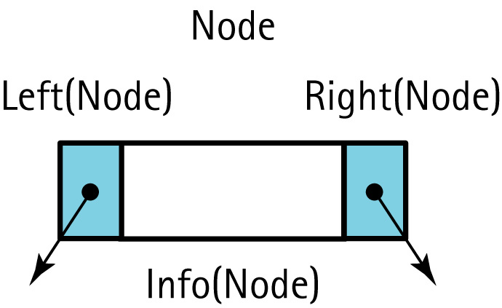
Node Terminology for a Tree Node
Notes:
Alternatively, Left is prev and Right is next

Slide 17
A Binary Search Tree (BST) is . . .
A special kind of binary tree in which:
1. Each node contains a distinct data value,
2. The key values in the tree can be compared using “greater than” and “less than”, and
3. The key value of each node in the tree is
less than every key value in its right subtree, and greater than every key value in its left subtree.

Slide 18
Shape of a binary search tree . . .
Depends on its key values and their order of insertion.
Insert the elements ‘J’ ‘E’ ‘F’ ‘T’ ‘A’ in that order.
The first value to be inserted is put into the root node.
‘J’

Slide 19
Inserting ‘E’ into the BST
Thereafter, each value to be inserted begins by comparing itself to the value in the root node, moving left it is less, or moving right if it is greater. This continues at each level until it can be inserted as a new leaf.
‘J’
‘E’

Slide 20
Inserting ‘F’ into the BST
Begin by comparing ‘F’ to the value in the root node, moving left it is less, or moving right if it is greater. This continues until it can be inserted as a leaf.
‘J’
‘E’
‘F’

Slide 21
Inserting ‘T’ into the BST
Begin by comparing ‘T’ to the value in the root node, moving left it is less, or moving right if it is greater. This continues until it can be inserted as a leaf.
‘J’
‘E’
‘T’
‘F’

Slide 22
Inserting ‘A’ into the BST
Begin by comparing ‘A’ to the value in the root node, moving left it is less, or moving right if it is greater. This continues until it can be inserted as a leaf.
‘J’
‘E’
‘T’
‘A’
‘F’

Slide 23
What binary search tree . . .
is obtained by inserting
the elements ‘A’ ‘E’ ‘F’ ‘J’ ‘T’ in that order?
‘A’

Slide 24
Binary search tree . . .
obtained by inserting
the elements ‘A’ ‘E’ ‘F’ ‘J’ ‘T’ in that order.
‘A’
‘E’
‘F’
‘J’
‘T’

Slide 25
Another binary search tree
‘J’
‘E’
‘T’
‘A’
‘H’
‘M’
‘K’
‘P’
Add nodes containing these values in this order:
‘D’ ‘B’ ‘L’ ‘Q’ ‘S’ ‘V’ ‘Z’

Slide 26
Is ‘F’ in the binary search tree?
‘J’
‘E’
‘T’
‘A’
‘H’
‘M’
‘V’
‘D’
‘K’
‘P’
‘Z’
‘B’
‘L’
‘Q’
‘S’

Slide 27
Class TreeType
// Assumptions: Relational operators overloaded
class TreeType
{
public:
// Constructor, destructor, copy constructor
...
// Overloads assignment
...
// Observer functions
...
// Transformer functions
...
// Iterator pair
...
void Print(std::ofstream& outFile) const;
private:
TreeNode* root;
};

Slide 28
bool TreeType::IsFull() const
{
NodeType* location;
try
{
location = new NodeType;
delete location;
return false;
}
catch(std::bad_alloc exception)
{
return true;
}
}
bool TreeType::IsEmpty() const
{
return root == NULL;
}

Slide 29
// Implementation of Final Version
int CountNodes(TreeNode* tree); // Prototype
int TreeType::GetLength() const
// Class member function
{
return CountNodes(root);
}
int CountNodes(TreeNode* tree)
// Recursive function that counts the nodes
{
if (tree == NULL)
return 0;
else
return CountNodes(tree->left) +
CountNodes(tree->right) + 1;
}

Slide 30
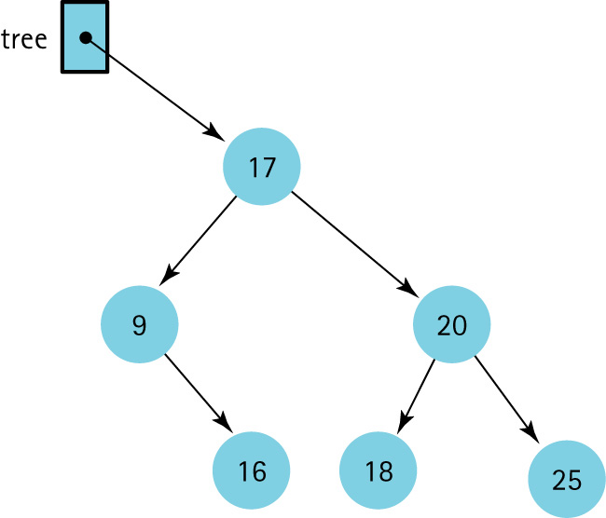
Retrieval Operation

Slide 31
Retrieval Operation
void TreeType::GetItem(ItemType& item, bool& found){
Retrieve(root, item, found);
}
void Retrieve(TreeNode* tree,ItemType& item, bool& found){
if (tree == NULL)
found = false;
else if (item < tree->info)
Retrieve(tree->left, item, found);
else if (item > tree->info)
Retrieve(tree->right, item, found);
else {
item = tree->info;
found = true;
}
}

Slide 32
The Insert Operation
A new node is always inserted into its appropriate position in the tree as a leaf.

Slide 33
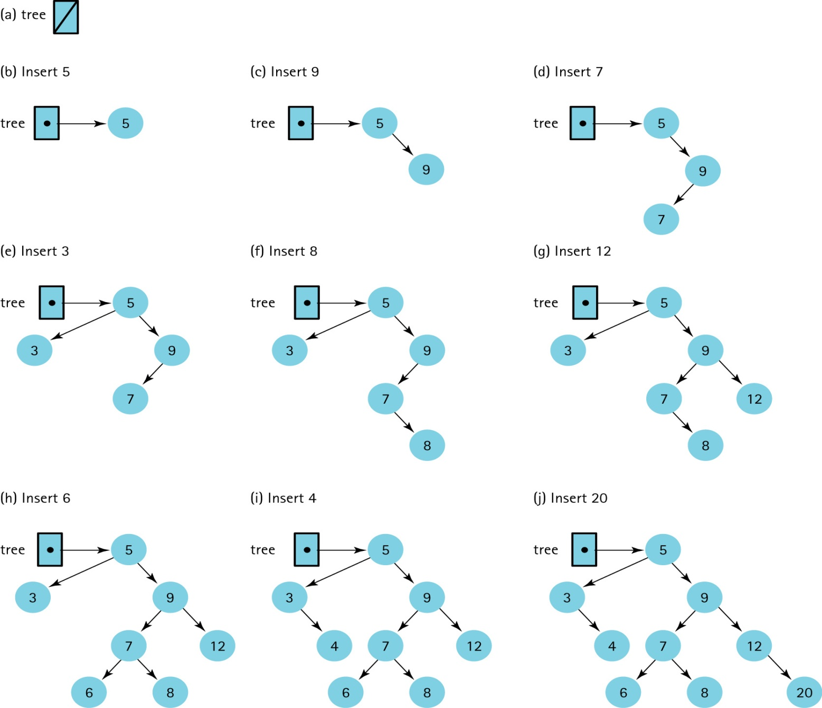
Insertions into a Binary Search Tree

Slide 34
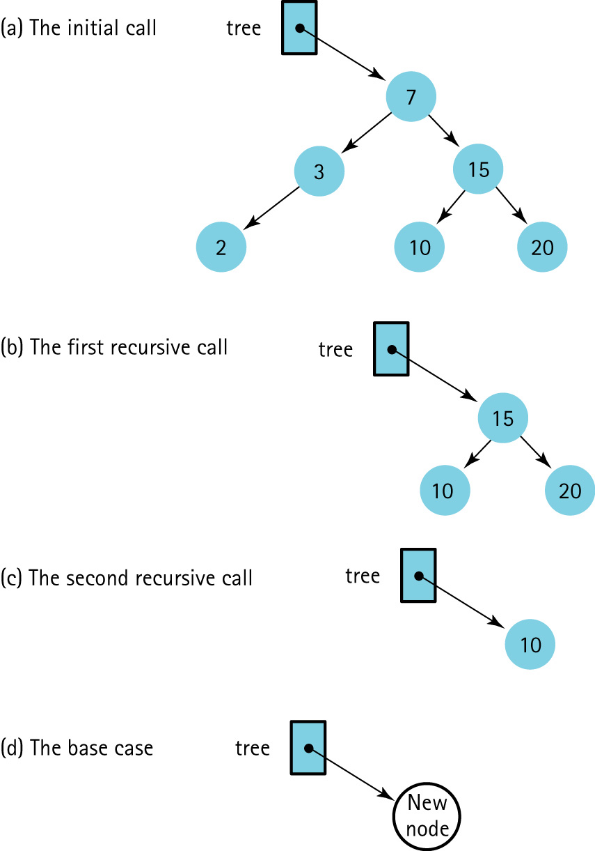
The recursive Insert operation
inserting 12

Slide 35
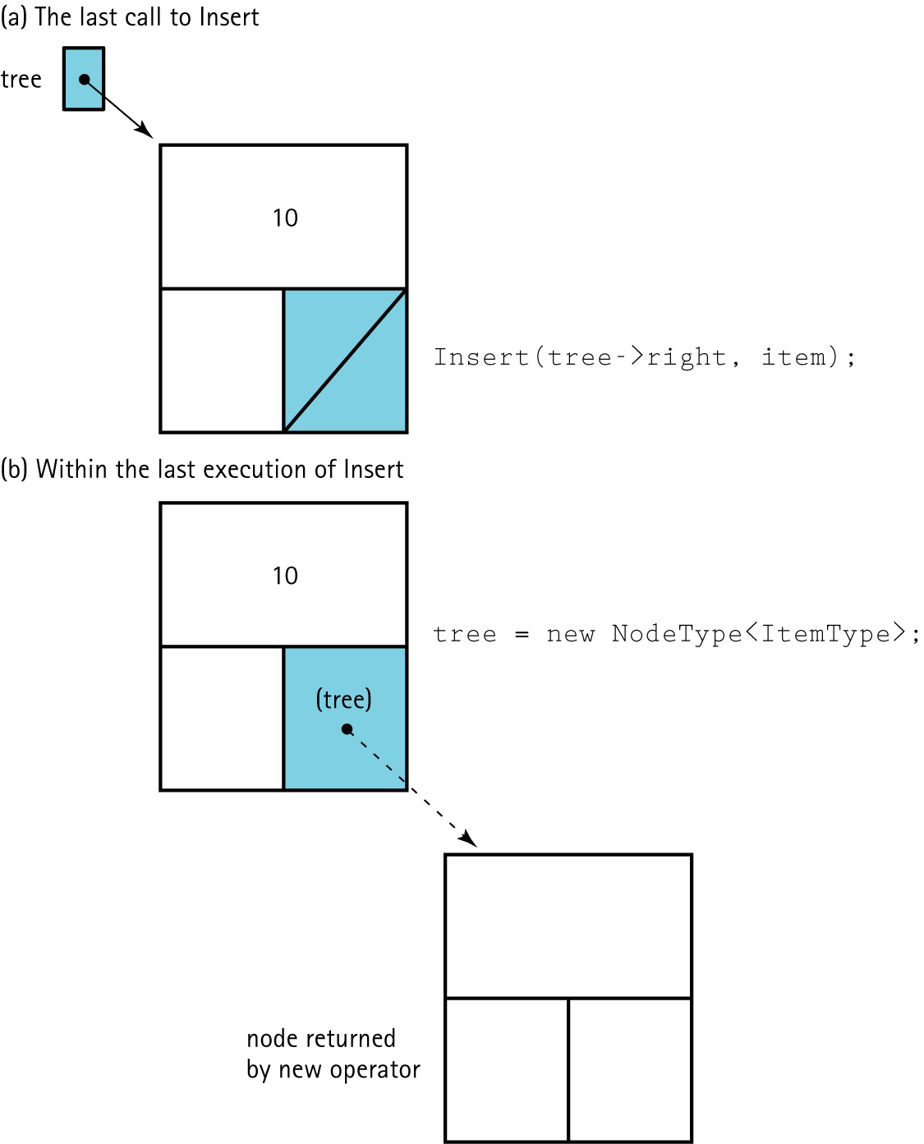
The tree parameter is a pointer within the tree

Slide 36
Recursive Insert
void Insert(TreeNode*& tree, ItemType item)
{
if (tree == NULL)
{// Insertion place found.
tree = new TreeNode;
tree->right = NULL;
tree->left = NULL;
tree->info = item;
}
else if (item < tree->info)
Insert(tree->left, item);
else
Insert(tree->right, item);
}

Slide 37
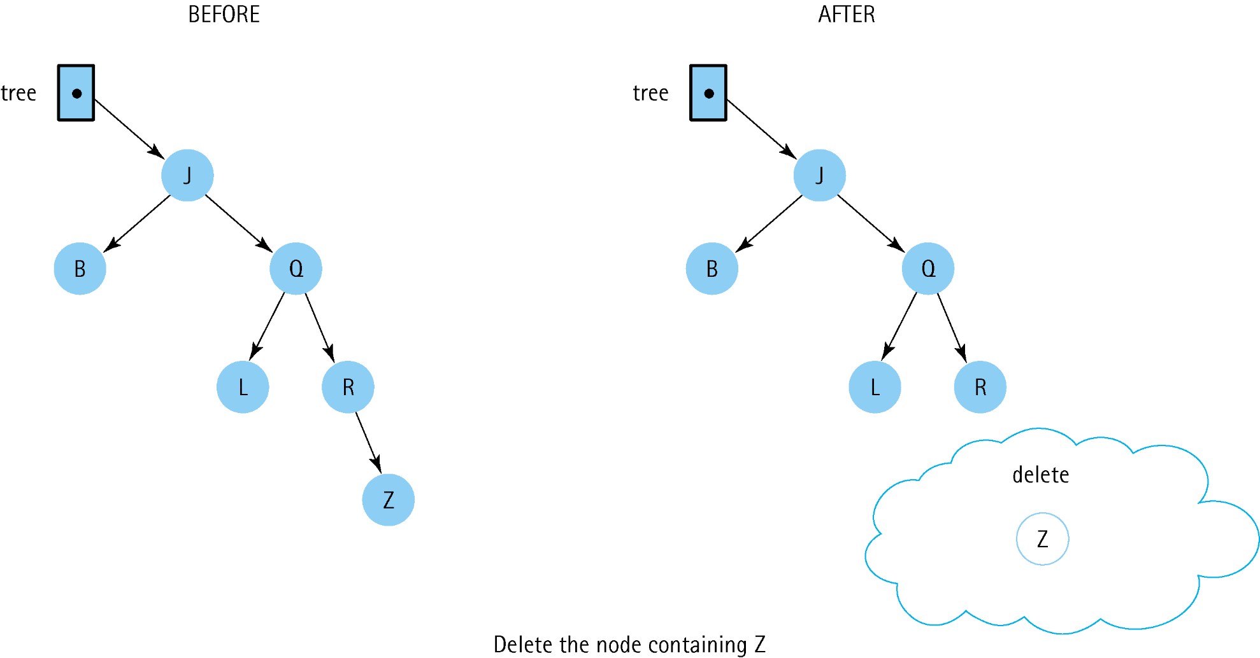
Deleting a Leaf Node

Slide 38
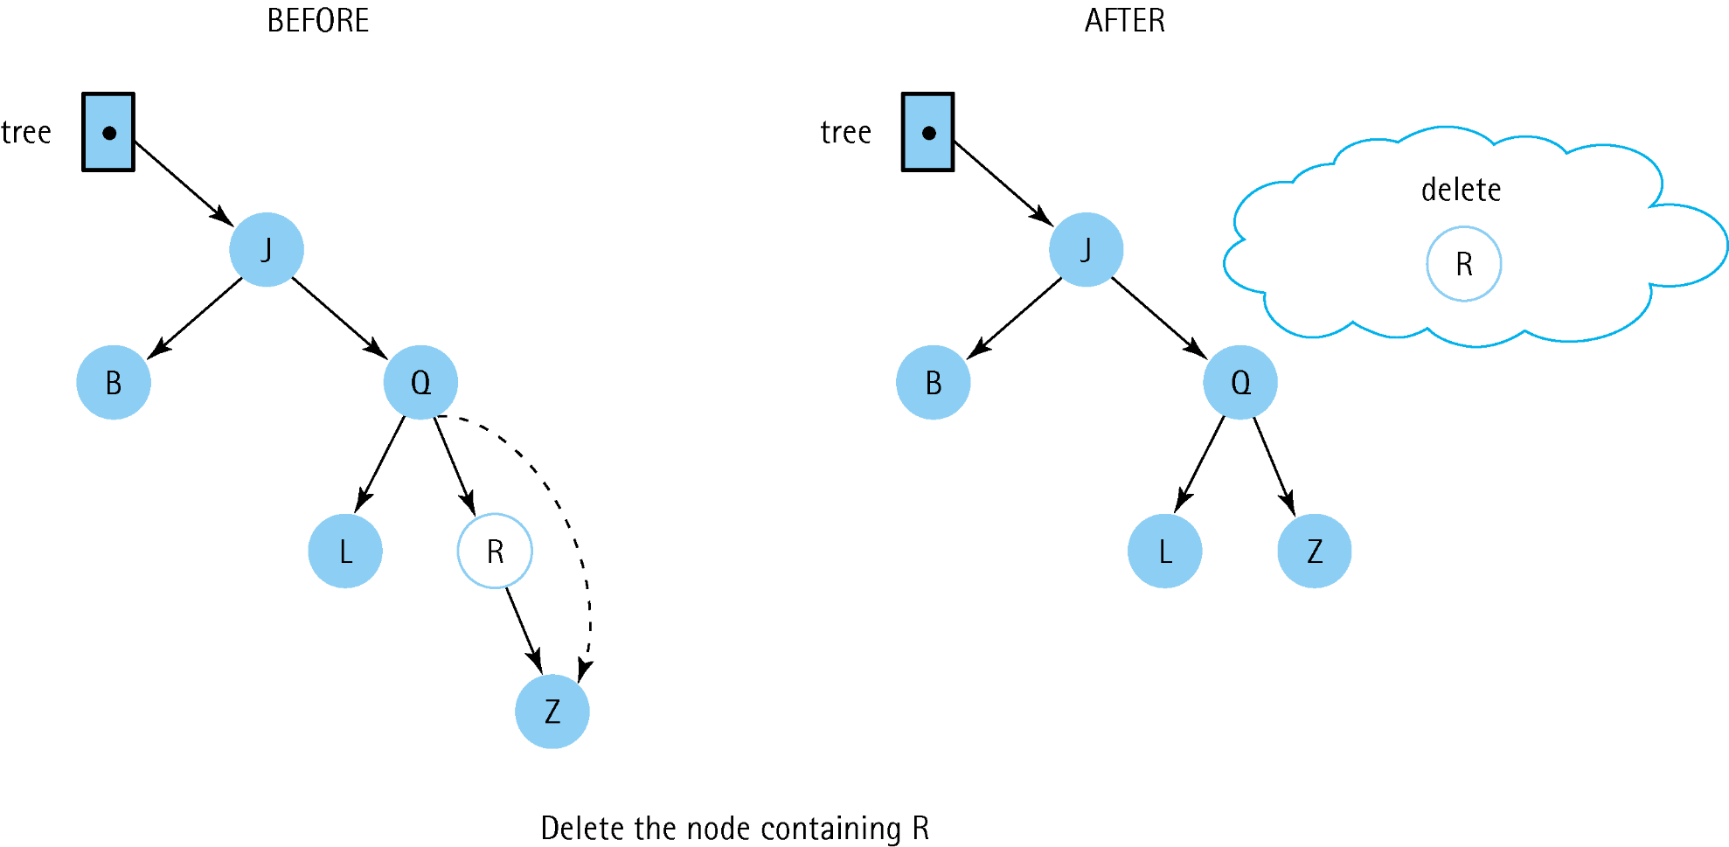
Deleting a Node with One Child

Slide 39
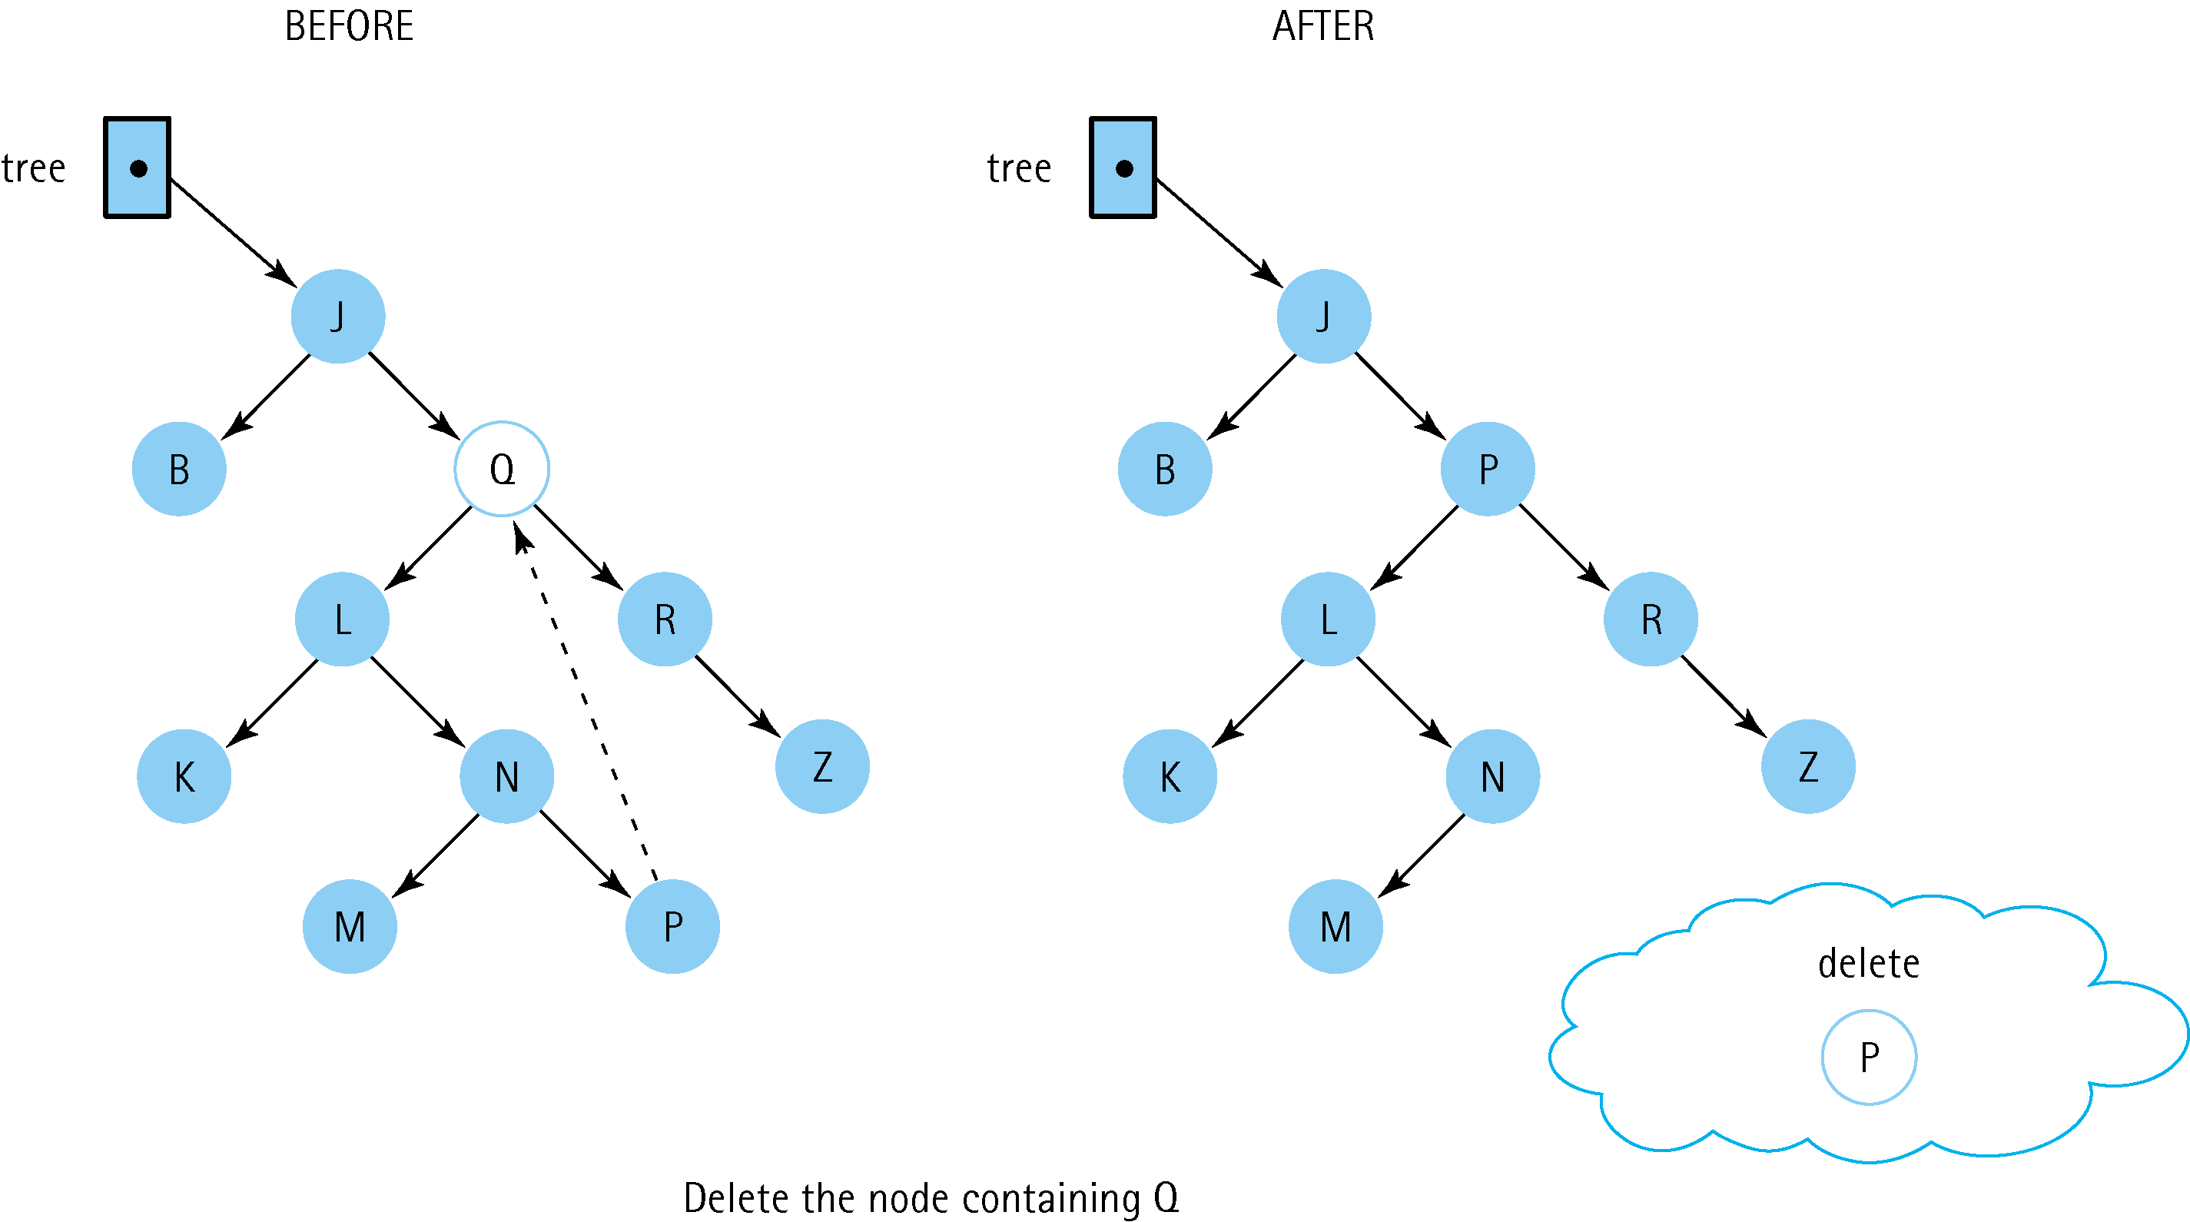
Deleting a Node with Two Children

Slide 40
DeleteNode Algorithm
if (Left(tree) is NULL) AND (Right(tree) is NULL)
Set tree to NULL
else if Left(tree) is NULL
Set tree to Right(tree)
else if Right(tree) is NULL
Set tree to Left(tree)
else
Find predecessor
Set Info(tree) to Info(predecessor)
Delete predecessor

Slide 41
Code for DeleteNode
void DeleteNode(TreeNode*& tree)
{
ItemType data;
TreeNode* tempPtr;
tempPtr = tree;
if (tree->left == NULL) {
tree = tree->right;
delete tempPtr; }
else if (tree->right == NULL){
tree = tree->left;
delete tempPtr;}
els{
GetPredecessor(tree->left, data);
tree->info = data;
Delete(tree->left, data);}
}

Slide 42
Definition of Recursive Delete
Definition: Removes item from tree
Size: The number of nodes in the path from the
root to the node to be deleted.
Base Case: If item's key matches key in Info(tree),
delete node pointed to by tree.
General Case: If item < Info(tree),
Delete(Left(tree), item);
else
Delete(Right(tree), item).

Slide 43
Code for Recursive Delete
void Delete(TreeNode*& tree, ItemType item)
{
if (item < tree->info)
Delete(tree->left, item);
else if (item > tree->info)
Delete(tree->right, item);
else
DeleteNode(tree); // Node found
}

Slide 44
Code for GetPredecessor
void GetPredecessor(TreeNode* tree,
ItemType& data)
{
while (tree->right != NULL)
tree = tree->right;
data = tree->info;
}

Slide 45
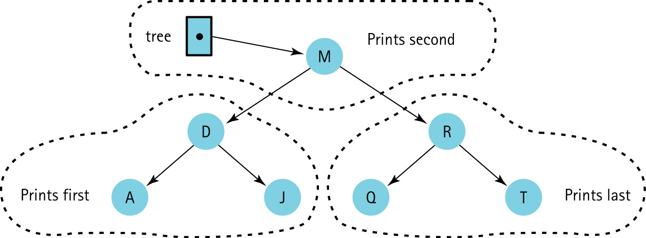
Printing all the Nodes in Order

Slide 46
Function Print
Function Print
Definition: Prints the items in the binary search
tree in order from smallest to largest.
Size: The number of nodes in the tree whose
root is tree
Base Case: If tree = NULL, do nothing.
General Case: Traverse the left subtree in order.
Then print Info(tree).
Then traverse the right subtree in order.

Slide 47
Code for Recursive InOrder Print
// NOTE: this is LNR infix traversal
void PrintTree(TreeNode* tree,
std::ofstream& outFile)
{
if (tree != NULL)
{
PrintTree(tree->left, outFile);
outFile << tree->info;
PrintTree(tree->right, outFile);
}
}

Slide 48
Destructor
void Destroy(TreeNode*& tree);
TreeType::~TreeType()
{
Destroy(root);
}
void Destroy(TreeNode*& tree)
{
if (tree != NULL)
{
Destroy(tree->left);
Destroy(tree->right);
delete tree;
}
}

Slide 49
Algorithm for Copying a Tree
if (originalTree is NULL)
Set copy to NULL
else
Set Info(copy) to Info(originalTree)
Set Left(copy) to Left(originalTree)
Set Right(copy) to Right(originalTree)

Slide 50
Code for CopyTree
void CopyTree(TreeNode*& copy,
const TreeNode* originalTree)
{
if (originalTree == NULL)
copy = NULL;
else
{
copy = new TreeNode;
copy->info = originalTree->info;
CopyTree(copy->left, originalTree->left);
CopyTree(copy->right, originalTree->right);
}
}

Slide 51
Inorder(tree)
if tree is not NULL
Inorder(Left(tree))
Visit Info(tree)
Inorder(Right(tree))
To print in alphabetical order: LNR

Slide 52
Postorder(tree)
if tree is not NULL
Postorder(Left(tree))
Postorder(Right(tree))
Visit Info(tree)
Visits leaves first : LRN
(good for deletion)

Slide 53
Preorder(tree)
if tree is not NULL
Visit Info(tree)
Preorder(Left(tree))
Preorder(Right(tree))
Useful with binary trees: NLR
(not binary search trees)

Slide 54
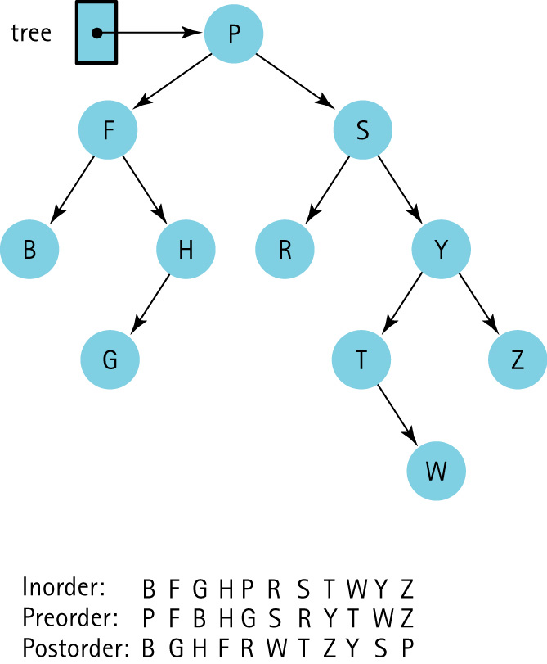
Three Tree Traversals
LNR
LRN
RLN

Slide 55
Our Iteration Approach
The client program passes the ResetTree and
GetNextItem functions a parameter indicating
which of the three traversals to use
ResetTree generates a queue of node contents in the indicated order
GetNextItem processes the node contents from the appropriate queue: inQue, preQue, postQue.

Slide 56
Code for ResetTree
void TreeType::ResetTree(OrderType order)
// Calls function to create a queue of the tree
// elements in the desired order.
{
switch (order)
{
case PRE_ORDER : PreOrder(root, preQue);
break;
case IN_ORDER : InOrder(root, inQue);
break;
case POST_ORDER: PostOrder(root, postQue);
break;
}
}

Slide 57
Code for GetNextItem
ItemType TreeType::GetNextItem(OrderType order,bool& finished)
{
finished = false;
switch (order)
{
case PRE_ORDER : preQue.Dequeue(item);
if (preQue.IsEmpty())
finished = true;
break;
case IN_ORDER : inQue.Dequeue(item);
if (inQue.IsEmpty())
finished = true;
break;
case POST_ORDER: postQue.Dequeue(item);
if (postQue.IsEmpty())
finished = true;
break;
}
}

Slide 58
Iterative Versions
FindNode
Set nodePtr to tree
Set parentPtr to NULL
Set found to false
while more elements to search AND NOT found
if item < Info(nodePtr)
Set parentPtr to nodePtr
Set nodePtr to Left(nodePtr)
else if item > Info(nodePtr)
Set parentPtr to nodePtr
Set nodePtr to Right(nodePtr)
else
Set found to true

Slide 59
Code for FindNode
void FindNode(TreeNode* tree, ItemType item,
TreeNode*& nodePtr, TreeNode*& parentPtr)
{
nodePtr = tree;
parentPtr = NULL;
bool found = false;
while (nodePtr != NULL && !found)
{ if (item < nodePtr->info)
{
parentPtr = nodePtr;
nodePtr = nodePtr->left;
}
else if (item > nodePtr->info)
{
parentPtr = nodePtr;
nodePtr = nodePtr->right;
}
else found = true;
}
}

Slide 60
PutItem
Create a node to contain the new item.
Find the insertion place.
Attach new node.
Find the insertion place
FindNode(tree, item, nodePtr, parentPtr);

Slide 61
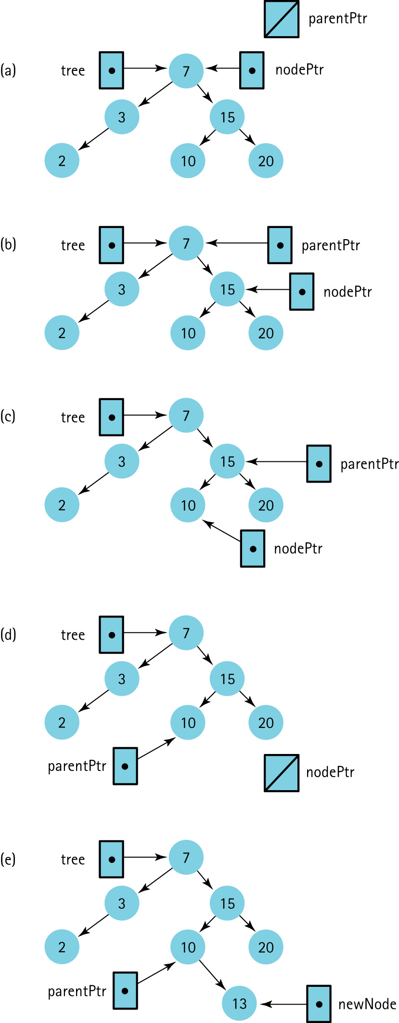
Using function FindNode to find the insertion point for 13

Slide 62
Using function FindNode to find the insertion point for 13

Slide 63
Using function FindNode to find the insertion point for 13

Slide 64
Using function FindNode to find the insertion point for 13

Slide 65
Using function FindNode to find the insertion point for 13

Slide 66
AttachNewNode
if item < Info(parentPtr)
Set Left(parentPtr) to newNode
else
Set Right(parentPtr) to newNode

Slide 67
AttachNewNode(revised)
if parentPtr equals NULL
Set tree to newNode
else if item < Info(parentPtr)
Set Left(parentPtr) to newNode
else
Set Right(parentPtr) to newNode

Slide 68
Code for PutItem
void TreeType::PutItem(ItemType item)
{
TreeNode* newNode;
TreeNode* nodePtr;
TreeNode* parentPtr;
newNode = new TreeNode;
newNode->info = item;
newNode->left = NULL;
newNode->right = NULL;
FindNode(root, item, nodePtr, parentPtr);
if (parentPtr == NULL)
root = newNode;
else if (item < parentPtr->info)
parentPtr->left = newNode;
else parentPtr->right = newNode;
}

Slide 69
Code for DeleteItem
void TreeType::DeleteItem(ItemType item)
{
TreeNode* nodePtr;
TreeNode* parentPtr;
FindNode(root, item, nodePtr, parentPtr);
if (nodePtr == root)
DeleteNode(root);
else
if (parentPtr->left == nodePtr)
DeleteNode(parentPtr->left);
else DeleteNode(parentPtr->right);
}

Slide 70
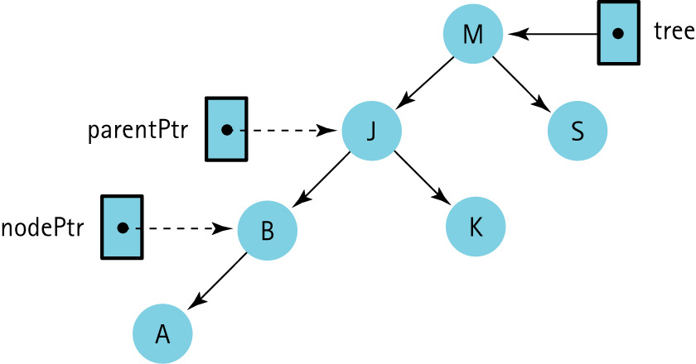
Pointers nodePtr and parentPtr Are External to the Tree

Slide 71
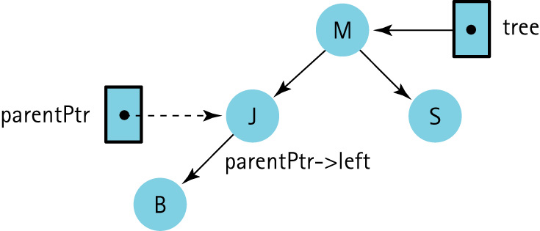
Pointer parentPtr is External to the Tree, but parentPtr-> left is an Actual Pointer in the Tree

Slide 72
With Array Representation
For any node tree.nodes[index]
  its left child is in tree.nodes[index*2 + 1]
  right child is in tree.nodes[index*2 + 2]
  its parent is in tree.nodes[(index – 1)/2].

Slide 73
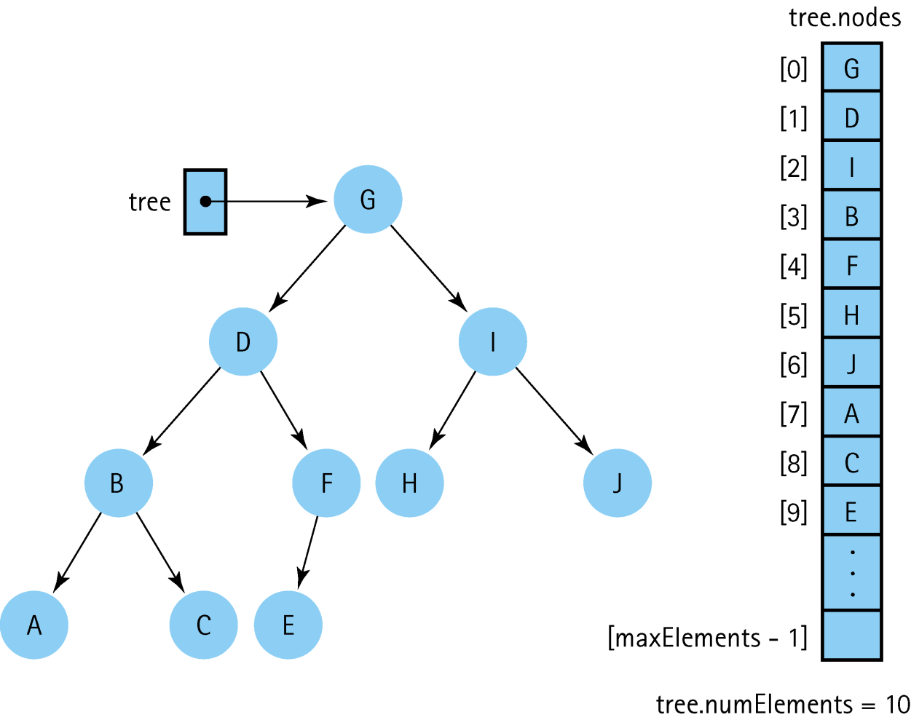
A Binary Tree and Its
Array Representation

Slide 74

Definitions
Full Binary Tree: A binary tree in which all of the leaves are on the same level and every nonleaf node has two children

Slide 75

Definitions (cont.)
Complete Binary Tree: A binary tree that is either full or full through the next-to-last level, with the leaves on the last level as far to the left as possible

Slide 76
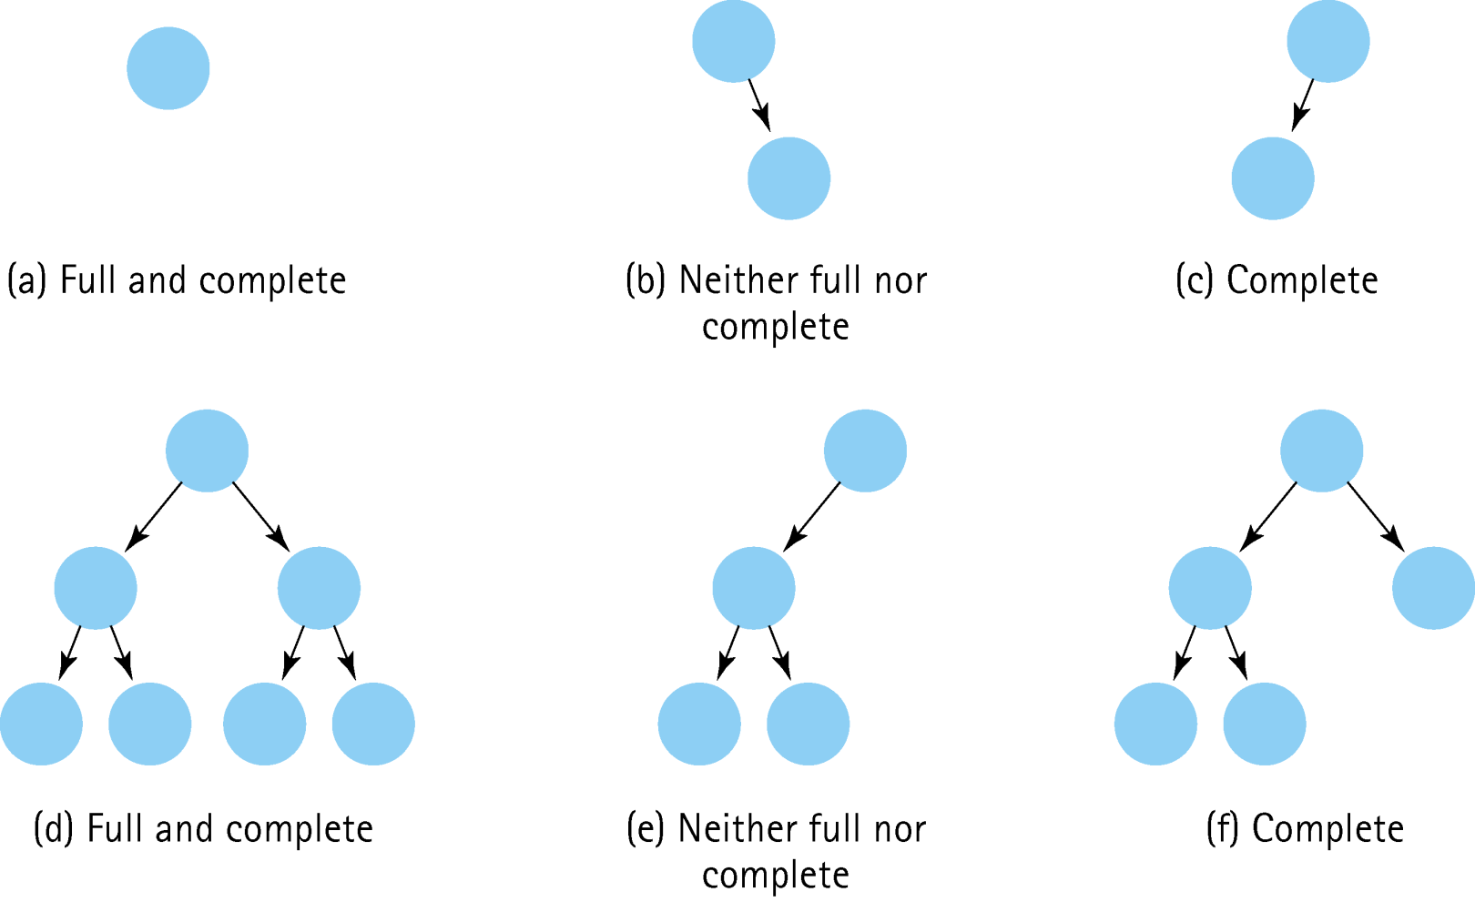
Examples of Different Types of Binary Trees

Slide 77
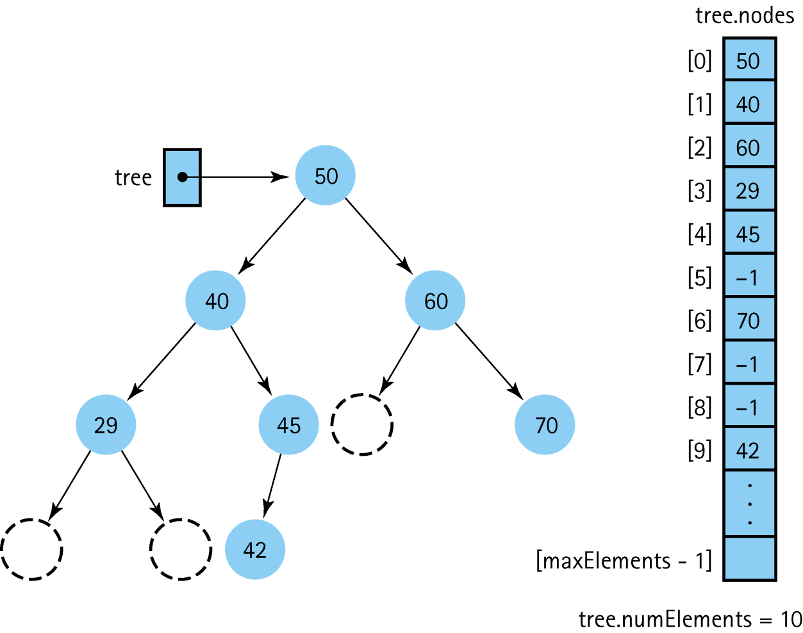
A Binary Search Tree Stored in an Array with Dummy Values

